Slide 1
Content Based Analysis in order to Detect SensitiveData P202106
Batuhan TATLISERT 201811057
Nazım DÖLEKÇEKİÇ 201811026
Alper PUNAR 201711055
Beril YOKARIBAŞ 201811069

Slide 2
Content
1-Introduction
1.1-Problem Definition
1.2-DLP
1.3-NLP
1.4-BERT
3-Proposed Solution
3.1-Crawling
3.2-OCR
3.3-Tokenize&Vectorize
3.4-Classification
3.5-Model Testing
3.6-Model Chosen
3.7-Embeding into DLP

Slide 3
1. Introduction
Data must be stored and protected against any kind of threat.
Lots of things can threaten security.
DLP systems can increase security against data leakage
Notes:
mahmut

Slide 4
1.1-PROBLEM DEFINITION
DLP systems are used to protect data against unauthorized disclosure.
In our project, we are going to build a text classification application by natural language processing and classify our documents with confidence scores in order to detect sensitive data.
We mainly focused on the classification aspect of our DLP project for now.
Notes:
mahmut

Slide 5

1.2-DLP

Slide 6
1.2-DLP
DLP is the abbreviation of Data Leakage Prevention.
Data Leakage (DL) means unauthorized or unwanted disclosure of the data.
DLP systems are used to protect sensitive data from being leaked to the public.
DLPS’s aim is to prevent this leakage differently from traditional protection measures. DLPSs is content-aware.
In our project, we mainly focused on e-mail DLP’s.

Slide 7

1.3-NLP

Slide 8

1.3-NLP
NLP is the abbreviation of Natural Language Processing.
NLP makes computers understand human language.
Examples to NLP: Google Assist, Alexa, and Siri.
NLP uses machine learning.
Language morphology levels are morphological lexical, syntactic, semantic, and pragmatic discourse.

Slide 9
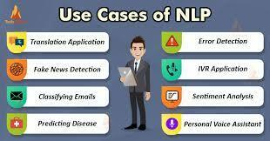
1.3-NLP
Examples to NLP: Information Retrieval, Character Recognition, Spell Checking, Machine Translation, Dialogue Systems.
In our project, we are going to build a text classification application by natural language processing and classify our documents with confidence scores in order to defect sensitive data.

Slide 10
1.4-What is Bert ?
BERT stands for Bidirectional Encoder Representations from Transformers.
It is developed by Google.
BERT uses a bidirectional transformer instead of a dictionary transformer.
Bidirectional models can have a deeper sense of context.
Bert can be used for tasks like sentiment analysis, text summarization, question answering, etc.

Slide 11
1.4-How to use BERT(fine-tuning)
Bert can be used for different NLP tasks, while only replacing with a new specific layer based on the task.
After adding a layer for output, supervised training can be performed using specific datasets.
Most hyper-parameters that are learned from scratch stay the same as in BERT pre-training. For this reason, fine-tuning training is fast.

Slide 12
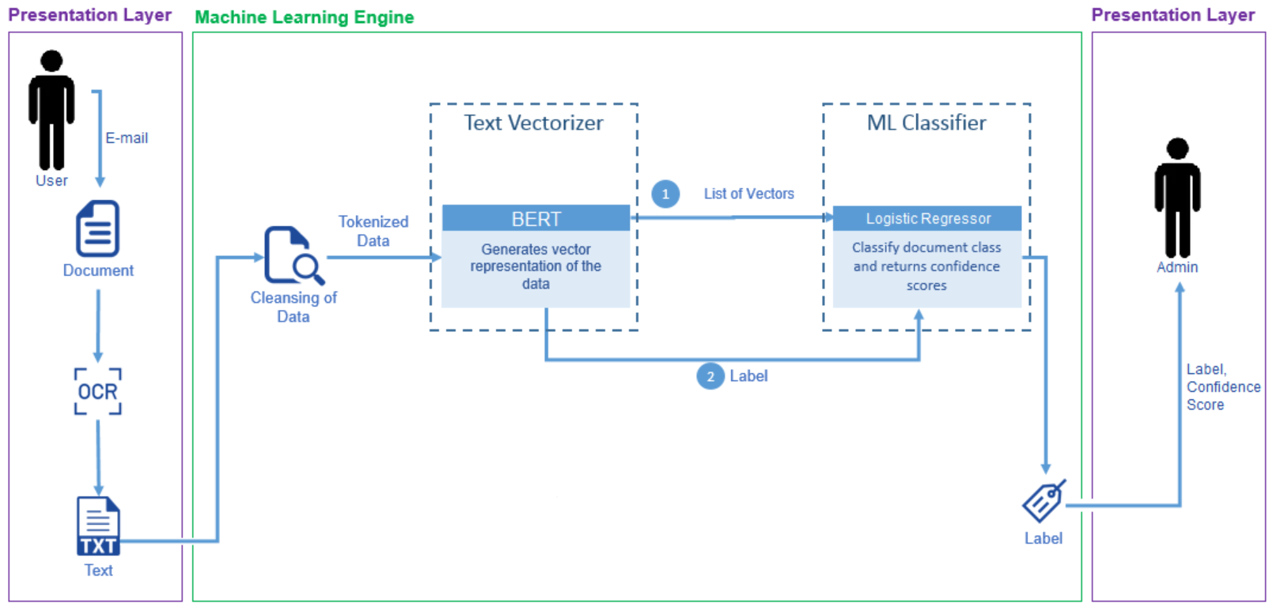
3. Proposed Solution

Slide 13
3.1 – Crawling
Finding suitable data by crawling.
Using Scrapy.
Crawling data one by one from search.edwardsnowden.com.

Slide 14
3.1 – Crawling
Finding suitable data by crawling.
Using Scrapy.
Crawling data one by one from search.edwardsnowden.com.
We found raw data via Snowden Doc Search’s github page.
Our data contains around 500 sensitive and 1000 un-sensitive documents.
For now we conducted our tests as binary classification.
We may find new data’s and test them later on.

Slide 15
3 .2 – OCR (Preparing data, transforming to text)
Transforming document’s (doc, pdf, pptx …) content to text.
Tesseract
Tested it with images and documents.

Slide 16
3.3 –Tokenize and Vectorize
BERT is used for both of these operations.
Fine-tuned BERT and its variations.
We managed to directly jump into the tokenizing process without the cleansing of data because preprocessing layer will handle this task.

Slide 17
3.4 Classification
We split data into %80 training and %20 for testings.
We added a 0.1 dropout layer and dense layer with sigmoid activation function to the BERT layer.
We tried various activation functions such as softmax, tanh, sigmoid functions.
We added a dense layer to convert the pooled output into binary output with the help of the sigmoid function.

Slide 18
3 .5 – Model Testing
Model Name | 5 EPOCH | 30 EPOCH
Bert L-12 (Uncased Eng) | 0.8667 | 0.8902
Bert L-24 (Uncased Eng) | 0.7529 | 0.7529
Electra Base | 0.8353 | 0.8667
Electra Large | 0.7529 | 0.7529
Electra Small | 0.8667 | 0.8706
LaBSE | 0.8431 | 0.8667
This Figure Shows Test Data Accuracy with different number of epochs

Slide 19
3 .5 – Model Testing
Model Name | 5 EPOCH | 30 EPOCH
Bert L-12 (Uncased Eng) | 0.8667 | 0.8902
Bert L-24 (Uncased Eng) | 0.7529 | 0.7529
Electra Base | 0.8353 | 0.8667
Electra Large | 0.7529 | 0.7529
Electra Small | 0.8667 | 0.8706
LaBSE | 0.8431 | 0.8667
*Test Data Accuracy

Slide 20
3 .6 – Model Chosen- Labse
EPOCH | Validation Accuracy
1. | 0.7373
2. | 0.8188
3. | 0.8118
4. | 0.8314
5. | 0.8667
6. | 0.8157
7. | 0.8392
8. | 0.8472
9. | 0.8000
EPOCH | Validation Accuracy
10. | 0.8275
11. | 0.8353
12. | 0.8275
13. | 0.8275
14. | 0.8235
15. | 0.8196
16. | 0.8235
17. | 0.8353
18. | 0.8553
EPOCH | Validation Accuracy
19. | 0.8275
20. | 0.8314
21. | 0.8196
22. | 0.8235
23. | 0.7961
24. | 0.8314
25. | 0.8353
26. | 0.8353
27. | 0.8353
EPOCH | Validation Accuracy
28. | 0.8353
29. | 0.8353
30. | 0.8353
31. | 0.8353
32. | 0.8353
33. | 0.8353
34. | 0.8353
35. | 0.8353

Slide 21
3 .6 – Model Chosen- Labse
EPOCH | Validation Accuracy
1. | 0.7373
2. | 0.8188
3. | 0.8118
4. | 0.8314
5. | 0.8667
6. | 0.8157
7. | 0.8392
8. | 0.8472
9. | 0.8000
EPOCH | Validation Accuracy
10. | 0.8275
11. | 0.8353
12. | 0.8275
13. | 0.8275
14. | 0.8235
15. | 0.8196
16. | 0.8235
17. | 0.8353
18. | 0.8553
EPOCH | Validation Accuracy
19. | 0.8275
20. | 0.8314
21. | 0.8196
22. | 0.8235
23. | 0.7961
24. | 0.8314
25. | 0.8353
26. | 0.8353
27. | 0.8353
EPOCH | Validation Accuracy
28. | 0.8353
29. | 0.8353
30. | 0.8353
31. | 0.8353
32. | 0.8353
33. | 0.8353
34. | 0.8353
35. | 0.8353

Slide 22
4 – Embeding into DLP
We are planning to integrate DLP into an e-mail server.
E-mail that is going to be send will preproccesed to text and later will be tokenize and vectorized. After that it will be sended to the model.
If model decides it contains sensitive information and it is above the threshold Admin will be warned.
Admin will decide what to do with this mail.

